Slide 1
The Future is Now: How Authentication Standards are Changing
Johannes B. Ullrich, Ph.D.
jullrich@sans.edu

Slide 2
About Me
Dean of Research, SANS Technology Institute
SANS Internet Storm Center https://isc.sans.edu
Created DShield.org
SANS Fellow
Past: Physicist, Web Developer
Teaching SEC522 (Defending Web Apps) SEC503 (Intrusion Detection)

Slide 3
The Future of Authentication
Outline
What does history tell us about passwords?
Multi-Factor Authentication and why it fails
Password Less Authentication
FIDO2/WebAuthn
Challenges implementing WebAuthn
Conclusion

Slide 4
The Future of Authentication
History
First use of passwords to login at least back in 1961 (Compatible Time-Sharing System, IBM 709)
“…and another quarter use passwords that are so obvious that an inventive 10-year-old could guess them. There are secret passwords and there are not-so-secret passwords. The best password is probably a nonsense word or number...” (Correy Sandler, How to telecommunicate: a personal computer user's guide, 1986)

Slide 5
The Future of Authentication
Password Vulnerabilities
Phishing
If you haven’t fallen for a phishing email yet, than you just haven’t seen a good one yet
Credential Stuffing / Reuse
Loss of Password Storage
Difficulty entering passwords in mobile devices

Slide 6
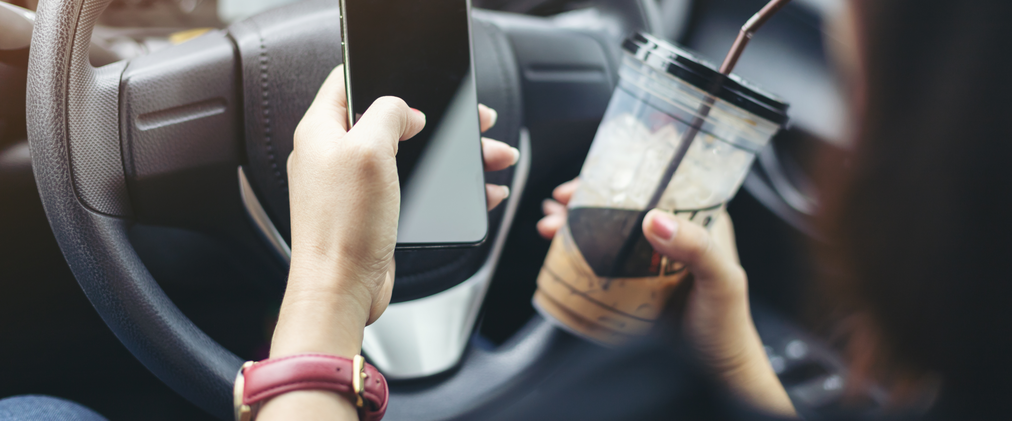
The Future of Authentication

Slide 7
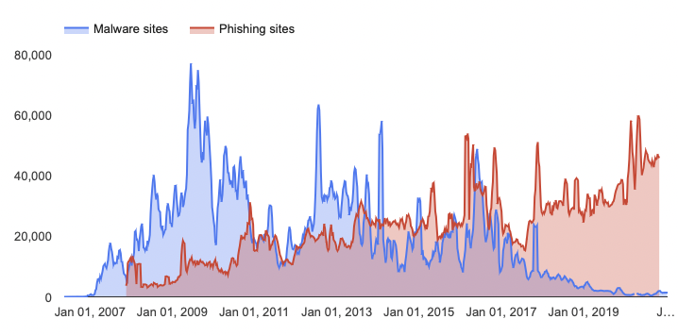
Phishing vs. Malware (Google Safebrowsing)

Slide 8
The Future of Authentication
Current Multifactor Authentication Technologies
Something I know (but nobody else does)
Password, personal information (SSN… )
Something I have (and nobody else can copy)
Hardware token, phone, physical address
Something I am (and is unique and doesn’t change)
Biometric sensor (fingerprint, face, retina...)

Slide 9
The Future of Authentication
Common 2-Factor Authentication Options
SMS/Phone Number
Known to be a weak 2nd factor
NIST spoke out against the use of SMS
Phone numbers can be ported / SS7 vulnerabilities can be used to re-route messages
But good enough for many applications
Reasonable user acceptance

Slide 10
The Future of Authentication
Common 2-Factor Authentication Options
One Time Passwords
Initially offered as a commercial solution (Hardware Tokens) or paper medium (OTP)
In recent years popularized as Google Authenticator
Relatively easy to use/implement, but substantial “real life” issues.

Slide 11
The Future of Authentication
Breaking Multi Factor Authentication
Many 2FA Options are not Phishing resistant
Phishing attack usually must implement machine-in-the-middle proxy, but not always
Reset of lost 2FA tokens tends to be difficult and can lead to downgrade attacks

Slide 12
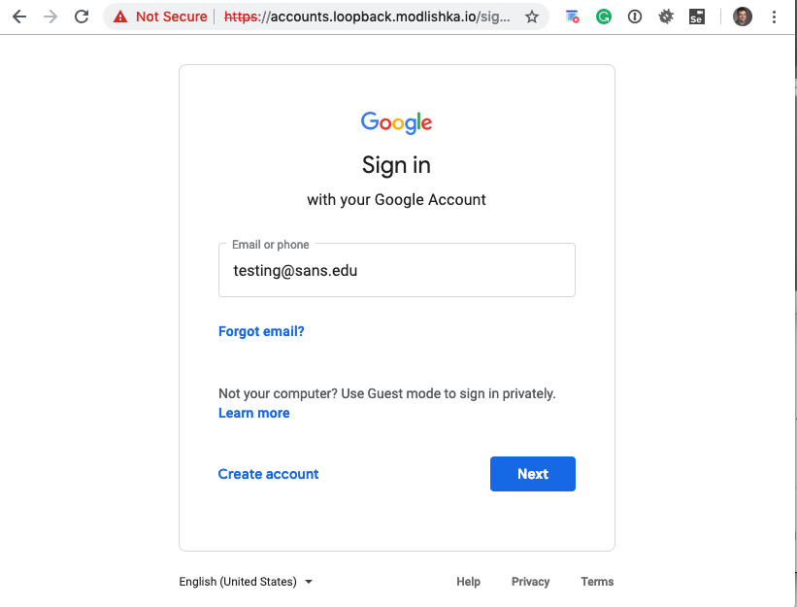
The Future of Authentication
Modlishka
Implements a proxy
Intercepts username/password
Proxys 2FA request
Collects 2FA value

Slide 13
Phishing Resistance
An authentication mechanism is considered phishing resistant if it is not “relay-able”: The user is not relaying the credential to the site.
Let’s put the machine in charge of figuring out if this is the right site.

Slide 14
The Future of Authentication
But Usability is the real problem
2FA does provide a significant security benefit (even the weakest 2FA methods!)
But usability issues kill it
Misplaced tokens
Complications in entering password and token
Mixing up numerous tokens
Mobile Applications

Slide 15
The Future of Authentication
Application Specific Passwords /OAUTH
Trying to solve problems with clients that need to continuously authenticate (for example mail clients)
Attacker may be able to steal them, and gain persistent access
OAUTH is a better solution, but still has the issue of credential theft and in some cases phishing

Slide 16
The Future of Authentication
If Passwords are the Problem: Lets remove passwords!
Passwordless Authentication
Usually relies on a public/private key pair
Key pair may be part of a mobile app or a token
Private key secured via biometrics/PIN/Device lock screen
Shortcut: one-time passwords via email (as used by Slack)

Slide 17
But what about all the biometric sensors we own?
Most mobile devices have:
Biometric sensors
Secure enclaves to store secret keys
APIs to lock/access secure enclaves using biometrics

Slide 18
The Future of Authentication
FIDO
FIDO Alliance (“Fast Identity Online”)
Attempt to standardize APIs to access hardware tokens
Standardizes how clients communicate to authenticators and servers
Very flexible. Allows for mobile (Software) clients, NFC, USB, BLE and more.

Slide 19
FIDO Authentication
Universal Second Factor (U2F)
Universal Authentication Framework (UAF)
( Password less Authentication. Now WebAuthn )
Client to Authenticator Protocols (CTAP)

Slide 20
The Future of Authentication
Design Criteria
Does not rely on passwords
Secures user’s privacy
Easy to use
Supports wide range of authenticators
Easy to implement

Slide 21
Web Authentication API Support
IE | Edge | Firefox | Chrome | Safari | Opera | iOS Safari | Android | Android Chrome
No | 18 | 60 | 67 | 14 | 54 | 14.3 | 67 | 71
Safari on IOs: experimental according to
https://www.caniuse.com/#feat=webauthn
Not supported: Opera Mini/Mobile, Firefox on Android

Slide 22
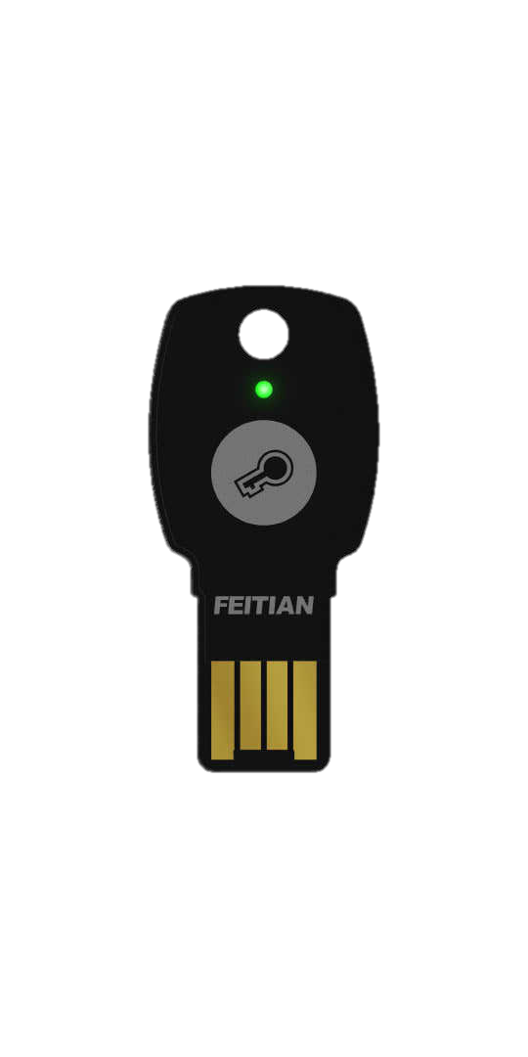
FIDO Ecosystem
Web Application (Server)
BLE, NFC, USB
CTAP
WebAuthn

Slide 23
Web Authentication (WebAuthn)
JavaScript API
Credential Management / Authentication API
Credentials: Public/Private keys
Does not necessarily require token/two factor
Very flexible. Could be just software or could be biometric token. Supports TPM.

Slide 24
Registration (1)
{ rp: {
id: “isc.sans.edu”,
name:”SANS Internet Storm Center”},
user: {
name: “jullrich@sans.edu”,
id: …},
},
challenge: <binary>
}

Slide 25
Registration (2)
Optional user interaction (biometrics, PIN, “press button”)
Key creates random keypair.
KeyHandle = AES (Random Private Key ⨂ AppID ⨂ Origin …)
Each hardware token stores a master secret that is used to encrypt the key

Slide 26
Registration (3)
Key handle (=encrypted private key)
Public Key
Signed challenge (proofs knowledge of private key)

Slide 27
Keypair Creation
Unique keypair for each application
No storage needed on authenticator token (only Master Secret)
Resetting Master Secret (“FIDO2 RESET”) invalidates all keys
Key encryption uses AES-256 in CCM mode
Credentials can only be used with specific RP (token is in charge to create keypair)

Slide 28
The Future of Authentication
Response from Browser
Browser receives data from Authenticator
Creates attestation response with:
Client data from Authenticator
Attestation object
Public key
Server validates data and stores public key with user account

Slide 29
FICO2 Authentication
Key Request Options (challenge)
“Get Assertion”
Signed Challenge
Signed Challenge

Slide 30
Attestation
Optional: Key includes “attestation” that proves key is authentic
Includes capabilities of key (transports supported, URL for logos…)
Signed by vendor
Can be used to identify vendor and require specific vendors
Not used by default
Attestation does not include uniquely identifying data

Slide 31
The Future of Authentication
Phishing / MitM Resistance
Browser/Authenticator decide which credentials to send (after registration)
User will be displayed the origin, but only matters for registration
“Token Binding”: After registration, challenge will include data encrypted with user’s public key

Slide 32
The Future of Authentication
Stolen / Lost Server Data
Server only keeps public keys
Unique to site. No use to anybody else
Not necessarily linked to a specific user (different sites get different public keys)

Slide 33
The Future of Authentication
Remaining Challenges
How to deal with lost tokens?
Should it be possible to backup tokens?
How to prove identity without token?
Just disable it and allow user to reset?

Slide 34
WebAuthn Summary
Standard that should be on your roadmap
May be a bit early to roll it out now (Safari? iOS?)
Solutions are available now, and the standard is vendor neutral
Do not implement anything now that would prevent you from doing FIDO2 later

Slide 35
Conclusion
Risk based authentication: Online Banking needs different security than a neighborhood bulletin board
Keep usability in mind!
Don’t fight password managers
Stick to widely supported standards

Slide 36
The Future of Authentication
Any Questions?
jullrich@sans.edu
https://isc.sans.edu
https://rsac.authonthemove.com
@johullrich
Daily Podcast …

