Slide 1
Zero Trust: Every Step Matters
George Finney
Chief Security Officer
Southern Methodist University

Slide 3
Strategy
Plan
Goal

Slide 4
NIST SP 800-207 Definition of Zero Trust
Zero trust (ZT) provides a collection of concepts and ideas designed to minimize uncertainty in enforcing accurate, least privilege per-request access decisions in information systems and services in the face of a network viewed as compromised.
Zero trust architecture (ZTA) is an enterprise’s cybersecurity plan that utilizes zero trust concepts and encompasses component relationships, workflow planning, and access policies.
Therefore, a zero trust enterprise is the network infrastructure (physical and virtual) and operational policies that are in place for an enterprise as a product of a zero trust architecture plan.
Notes:
Security, privacy, and policy concerns – Every Step Matters

Slide 6
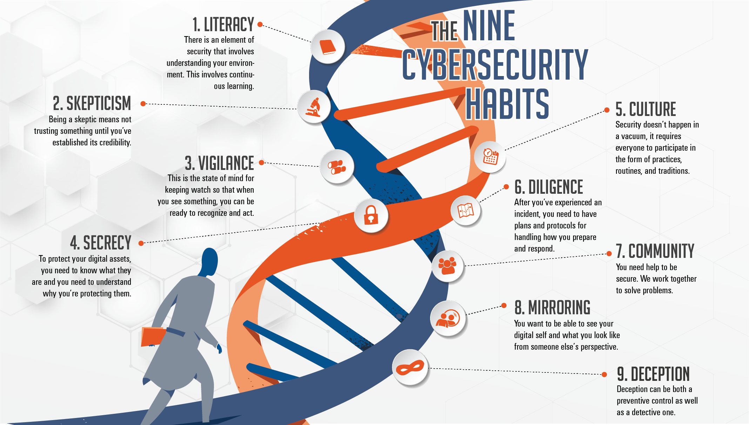

Slide 7
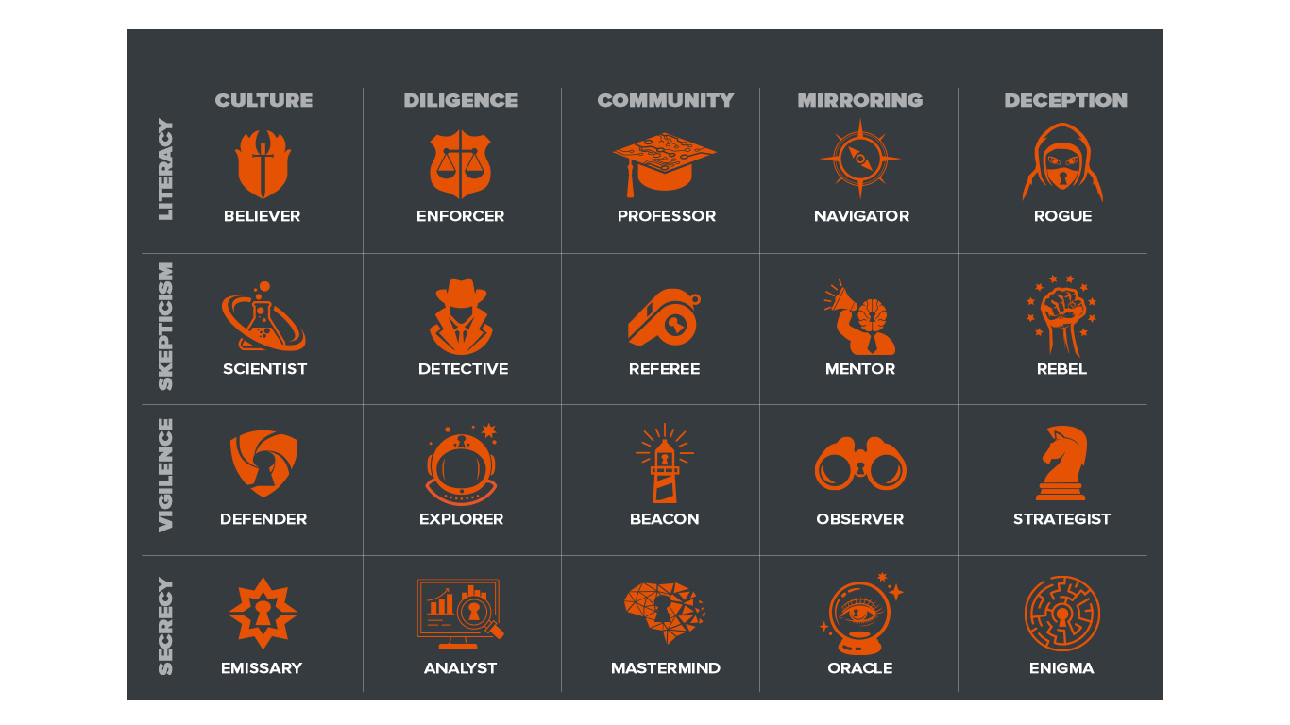

Slide 8
wellawaresecurity.com/cyber-personality-test

Slide 9
Zero Trust Principles
3. Determine Who/What Needs Access
1. Focus on Business Outcomes
2. Design From The Inside Out
4. Inspect and Log All Traffic
Notes:
Start with the Biz
What’s a strategy?
What’s a protect surface (mapping chart)
Map Flows
Mapping to NIST

Slide 10
Zero Trust Design Methodology
1. Define Your Protect Surface
2. Map Your Transaction Flows
3. Architect Your Environment
4. Create Zero Trust Policies
5. Monitor and Maintain
Notes:
Why inside out? (Phy sec)
Learning curve
Culture sustains it
Maturity model
6-9 month cycle
SOC improvement

Slide 11
Strategic Plan
Mission/Vision Statement
Board/Leadership Interviews
Risk Register
Service Catalog
1. Focus on Business Outcomes
Notes:
Start with the Biz
What’s a strategy?
What’s a protect surface (mapping chart)
Map Flows
Mapping to NIST

Slide 12
Business Impact Analysis
Privacy Impact Analysis
Business Continuity Plans
Device Inventory
Data Inventory
Software Inventory
2. Design From The Inside Out
Notes:
Start with the Biz
What’s a strategy?
What’s a protect surface (mapping chart)
Map Flows
Mapping to NIST

Slide 13
HR Job Data
GDPR Data Mapping
Business Owner Interviews
Identity and Access Governance
Governance, Risk, and Compliance
3. Determine Who/What Needs Access
Notes:
Start with the Biz
What’s a strategy?
What’s a protect surface (mapping chart)
Map Flows
Mapping to NIST

Slide 14
Network Detection and Response
Security Information, and Event Management
Configuring Network, Server, Endpoint, and Application Logging
Change Control
Real Time API Monitoring
4. Inspect and Log All Traffic
Notes:
Start with the Biz
What’s a strategy?
What’s a protect surface (mapping chart)
Map Flows
Mapping to NIST

Slide 15
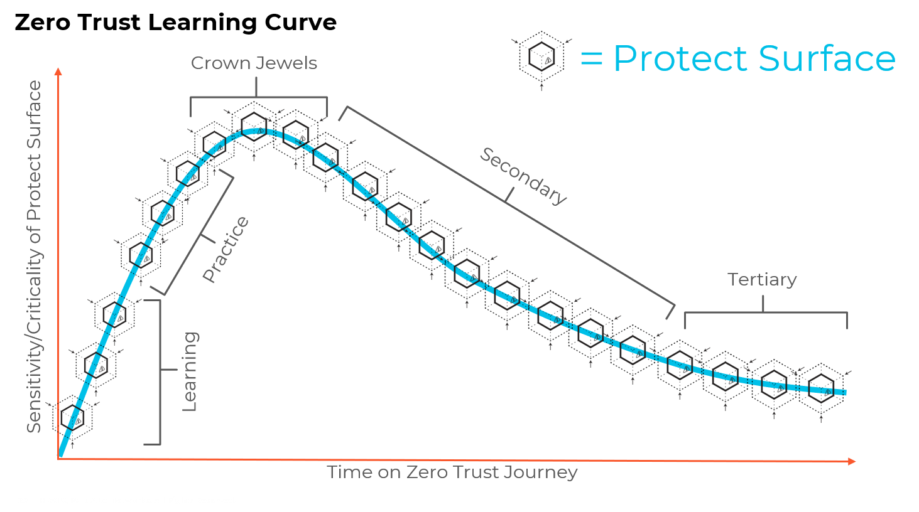
Notes:
Why inside out? (Phy sec)
Learning curve
Culture sustains it
Maturity model
6-9 month cycle
SOC improvement

Slide 16
Contains Blast Radius
Auto Discovery of All Assets
Data Classification
Microsegmentation
1. Define Your Protect Surface
Notes:
Why inside out? (Phy sec)
Learning curve
Culture sustains it
Maturity model
6-9 month cycle
SOC improvement

Slide 17
The Zero Trust “OSI Model”
Identity
Device/Workload
Access
Transaction
Zero Trust for Users
Validate users with strong authentication
Verify user device integrity
Enforce least-privilege user access to data and applications
Scan all content for malicious activity and data theft
Zero Trust for Applications
Validate developers, devops, and admins with strong authentication
Verify workload integrity
Enforce least-privilege access for workloads accessing other workloads
Scan all content for malicious activity and data theft
Zero Trust for Infrastructure
Validate all users with access to the infrastructure
Identify all devices including IoT
Least-privilege access segmentation for native and third-party infrastructure
Scan all content within the infrastructure for malicious activity and data theft

Slide 18
No Unknown Traffic
Safelisting
Transaction Flows are automatically mapped and visualized
IT Governance vets all flows
2. Map Your Transaction Flows
Notes:
Why inside out? (Phy sec)
Learning curve
Culture sustains it
Maturity model
6-9 month cycle
SOC improvement

Slide 19
No Reference Architecture
Bespoke Controls
Align Risk with Resources
Red Teaming/Pre-Mortems
Environment Specific
3. Architect Your Environment
Notes:
Why inside out? (Phy sec)
Learning curve
Culture sustains it
Maturity model
6-9 month cycle
SOC improvement

Slide 20
Kipling Policies
Layer 7 Policy rather than Layer 3
Identity Integrations (Policy Engine, SASE, etc.)
Terminations and Transfers
Governance, Risk, and Compliance
4. Create Zero Trust Policies
Notes:
Why inside out? (Phy sec)
Learning curve
Culture sustains it
Maturity model
6-9 month cycle
SOC improvement

Slide 21
Security Operations Center
Managed Security Solutions Providers
Penetration Testing
Tabletop Exercises
Incident Response Teams
5. Monitor and Maintain
Notes:
Why inside out? (Phy sec)
Learning curve
Culture sustains it
Maturity model
6-9 month cycle
SOC improvement

Slide 22
STEP | INITIAL (1) The initiative is undocumented and performed on an ad hoc basis with processes undefined. Success is dependent on individual efforts | REPEATABLE (2) Tthe process is documented and is predictably repeatable, using lessons learned in the initial phase. | DEFINED (3) Processes for success have been defined and documented | MANAGED (4) Processes are monitored and controlled; efficacy is measurable | OPTIMIZED (5) Focus is on continuous optimization
1. Define your protect surface Determine which single DAAS element will be protected inside of the defined protect surface | The DAAS element is unknown or discovered manually; Data classification is not done or is incomplete.. | The use of automated tools to discover and classify DAAS elements has begun, but is not standardized. | Data classification training and processes have been introduced and are maturing; Protect surface discovery is becoming automated. | New or updated DAAS elements are immediately discovered, classified as assigned to the correct protect surface in an automated manner. | Discovery and classification processes are fully automated
2. Map the transaction flows The mapping of the transactions flows to and from the protect surface shows how various DAAS components interact with other resources on your network and, therefore, where to place controls. | Flows are conceptualized based interviews and workshops | Traditional scanning tools and event logs are used to construct approximate flow maps. | A flow mapping process is in place. Automated tools are beginning to be deployed. | Automated tools create precise flow maps. All flow maps are validated with system owners. | Transaction flows are automatically mapped across all locations in real time.
3. Architect a Zero Trust environment A Zero Trust architecture is designed based upon the protect surface and the interaction of resources based upon the flow maps. | With little visibility and an undefined protect surface, the architecture cannot be properly designed | Protect surface is established based on current resources and priorities | The basics of the Protect Surface enforcement is complete, including placing segmentation gateways in the appropriate places | Additional controls are added to evaluate multiple variables (e.g., endpoint controls, SAAS and API controls) | Controls are enforced using a combination of hardware and software capabilities
4. Create Zero Trust policy Create Zero Trust policy following the Kipling Method of Who, What, When, Where, Why and How | Policy is written at Layer 3 | Additional "who" statements are starting to be identified to address business needs; User IDs of applications and resources are known, but access rights are unknown | The team works with the business to determine who or what should have access to the Protect Surface | Custom user-specific elements are created and defined by policy, reducing policy space and number of users with access | Layer 7 policy is written for granular enforcement; Only known allowed traffic and legitimate application communication is allowed
5. Monitor and maintain Telemetry from all controls in the protection chain are capture, analyzed and used to stop attacks in real-time and enhance defenses to create more robust protections over time. | Visibility into what is happening on the network is low | Traditional SIEM or log repositories are available, but the process is still mostly manual | Telemetry is gathered from all controls and is sent to a central data lake | Machine learning tools are applied to the data lake for context into how traffic is used in the environment | Data is incorporated from multiple sources and used to refine Steps 1-4; Alerts and analysis is automated

Slide 23
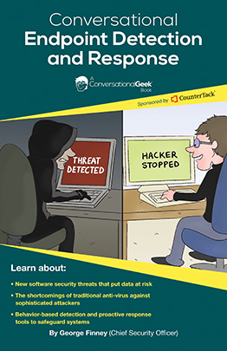
Questions?
George Finney – george@wellawaresecurity.com
twitter.com/wellawaresecure
LinkedIn.com/in/georgefinney

